Slide 1

“I Am The Good Shepherd”
The Seven “I Am” Statements of Jesus Series

Slide 2
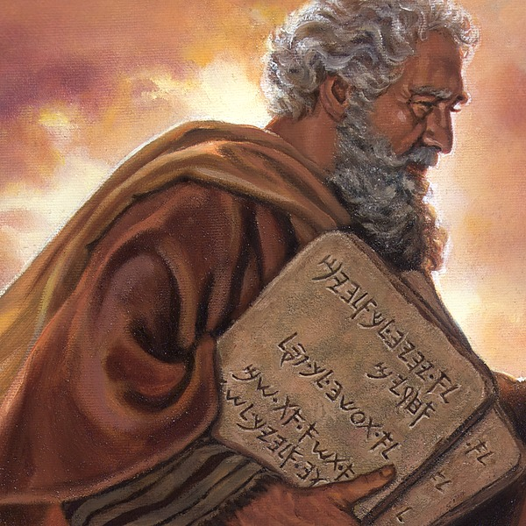
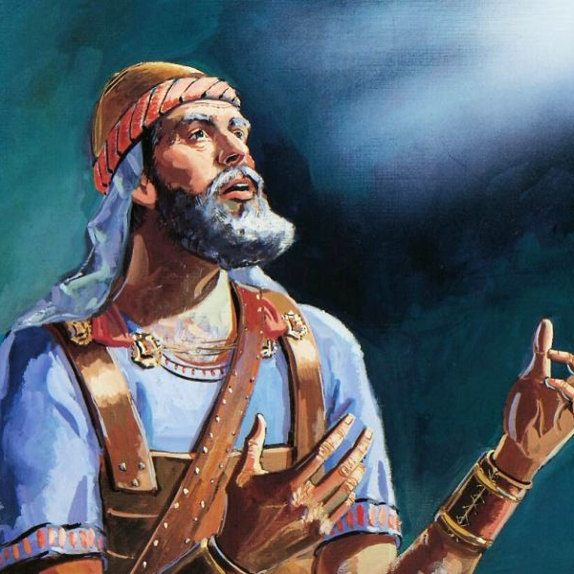
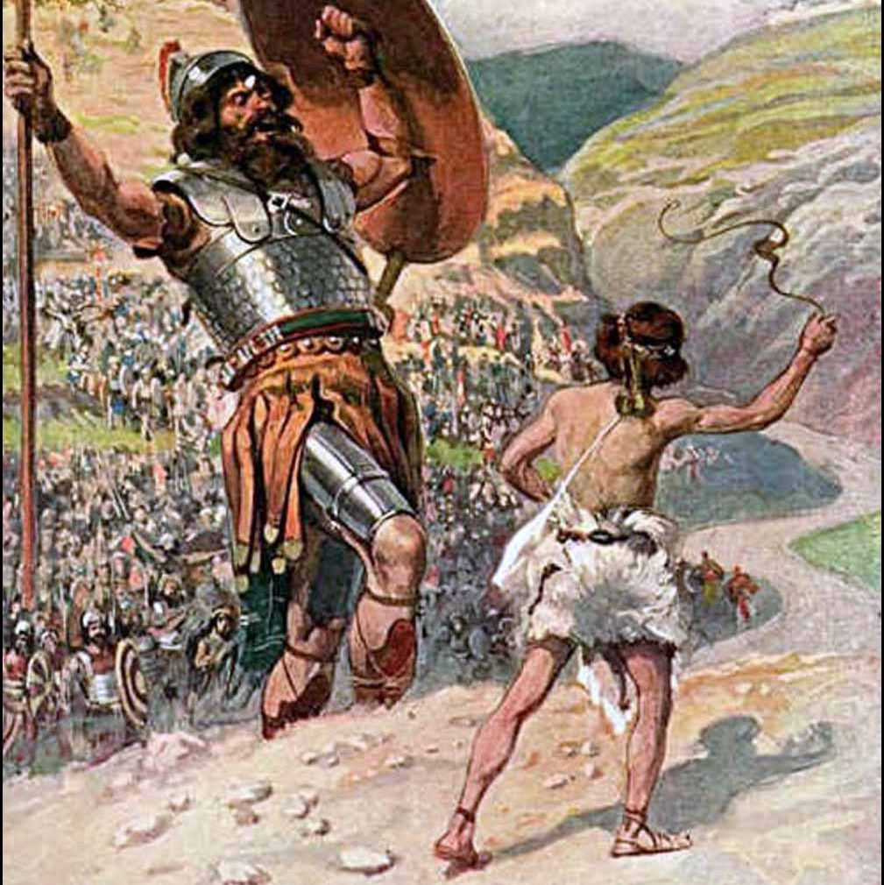
Shadows of Shepherds
Other examples of Shepherds in the Bible
Moses
Joshua
David
Exodus 3:1
Numbers 27:17
1 Samuel 17:34
Now Moses kept the flock of Jethro his father in law, the priest of Midian: and he led the flock to the backside of the desert, and came to the mountain of God, even to Horeb.
Which may go out before them, and which may go in before them, and which may lead them out, and which may bring them in; that the congregation of the LORD be not as sheep which have no shepherd.
And David said unto Saul, Thy servant kept his father's sheep, and there came a lion, and a bear, and took a lamb out of the flock:

Slide 3
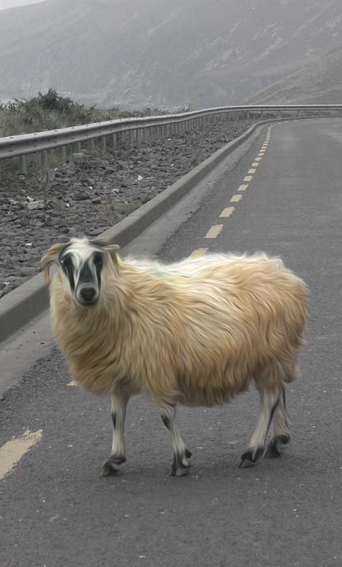
The Not So Good
Ezekiel 34:1-24
Feed themselves; not the flock
Don’t heal
Don’t protect
Don’t serve
Don’t care

Slide 4
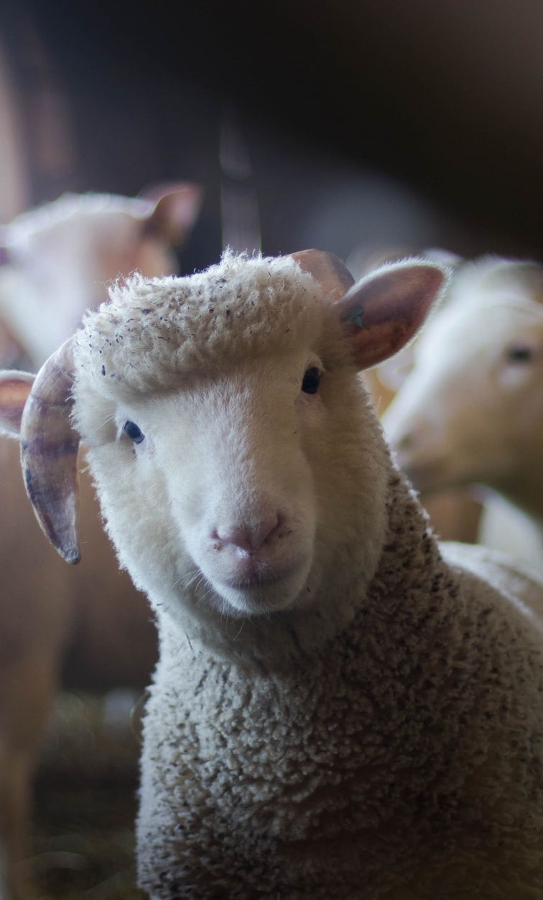
The Sheep
Characteristics of Sheep
Male = ram; Female = ewe; Younger sheep = lamb
Good hearing; sensitive to noise
Peripheral vision; can see behind without turning head
Poor depth perception; tendency to move out of dark and into well lit areas
Gregarious (sociable / in flocks)
Strong tendency to follow
Recognize faces, emotions, and can learn their names
Predators Canidae (dogs, wolves, foxes, jackles, etc.)

Slide 5
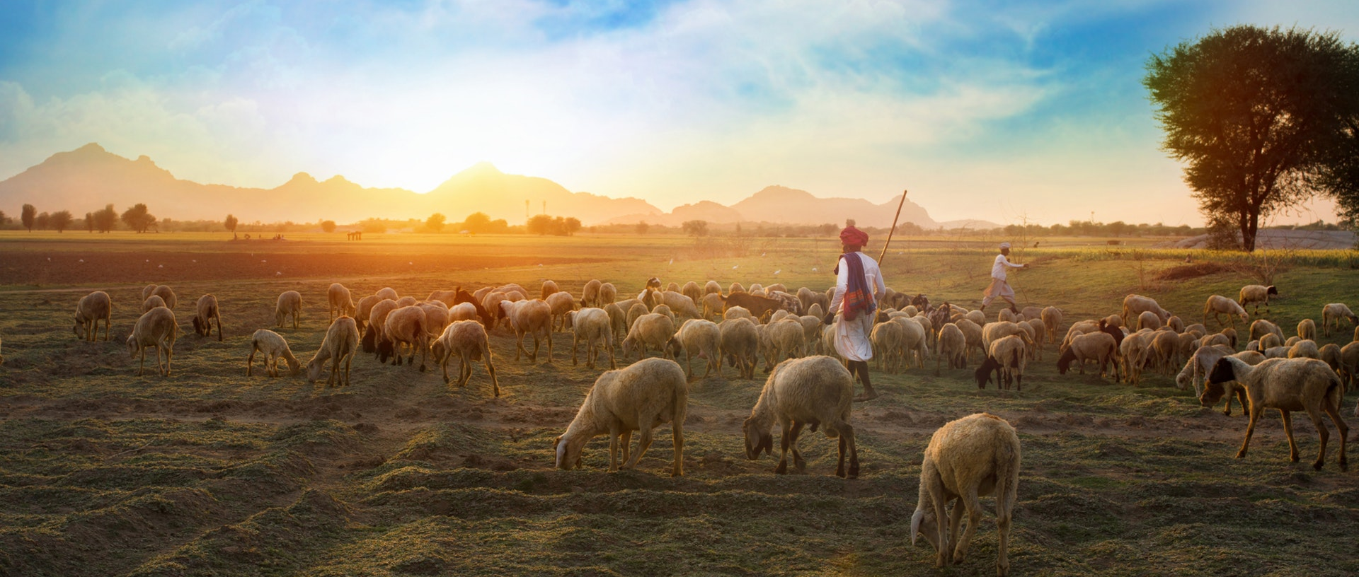
John 10:1-18
Context
Setting: Jesus has just healed a forty year old man who was blind from birth (John 9). There was a dispute because Jesus healed this man on the Sabbath day. The Pharisees called the man and his parents in for questioning. They were trying to determine if Jesus was from God or if He was wicked for healing the man on the Sabbath. Jesus then rebuked and addressed the Pharisees and their behavior towards God’s people.

Slide 6
John 10:1-6
Verily, verily, I say unto you, He that entereth not by the door into the sheepfold, but climbeth up some other way, the same is a thief and a robber. 2 But he that entereth in by the door is the shepherd of the sheep. 3 To him the porter openeth; and the sheep hear his voice: and he calleth his own sheep by name, and leadeth them out. 4 And when he putteth forth his own sheep, he goeth before them, and the sheep follow him: for they know his voice. 5 And a stranger will they not follow, but will flee from him: for they know not the voice of strangers. 6 This parable spake Jesus unto them: but they understood not what things they were which he spake unto them.
“Verily, verily, I say unto you, He that entereth not by the door into the sheepfold, but climbeth up some other way, the same is a thief and a robber.”
Sheepfold – a strong fenced enclosure for the protection of the sheep gathered within it
Thief - kléptēs – a thief who steals by stealth (in secret), rather than in the open with violence (WS, 591).
Robber - lēstḗs – a thief ("robber"), stealing out in the open (typically with violence). 3027 /lēstḗs ("a bandit, briard") is a thief who also plunders and pillages – an unscrupulous marauder (malefactor), exploiting the vulnerable without hesitating to use violence.
Satan wants to give us a false name

Slide 7

DISCUSSION QUESTION
With So Many Voices Around, How Can We Distinguish the Voice of Jesus?

Slide 8
John 10:7-12
Then said Jesus unto them again, Verily, verily, I say unto you, I am the door of the sheep. 8 All that ever come before me are thieves and robbers: but the sheep did not hear them. 9 I am the door: by me if any man enter in, he shall be saved, and shall go in and out, and find pasture. 10 The thief cometh not, but for to steal, and to kill, and to destroy: I am come that they might have life, and that they might have it more abundantly. 11 I am the good shepherd: the good shepherd giveth his life for the sheep. 12 But he that is an hireling, and not the shepherd, whose own the sheep are not, seeth the wolf coming, and leaveth the sheep, and fleeth: and the wolf catcheth them, and scattereth the sheep.
“I am the good shepherd: the good shepherd giveth his life for the sheep.”
Jesus is the door.
“Hear” in this context means to yield to, hear and obey, to hear one.
Pasturage, fodder, food He shall not want the needful supplies for the true life.
Jesus gives life so we can find life.
Jesus cares deeply about the sheep because He is the same type.
Hireling – one who is hired, or who serves for wages. mercenary, prostitute. No care; no ownership; no warning.

Slide 9
John 10:13-18
13 The hireling fleeth, because he is an hireling, and careth not for the sheep. 14 I am the good shepherd, and know my sheep, and am known of mine. 15 As the Father knoweth me, even so know I the Father: and I lay down my life for the sheep. 16 And other sheep I have, which are not of this fold: them also I must bring, and they shall hear my voice; and there shall be one fold, and one shepherd. 17 Therefore doth my Father love me, because I lay down my life, that I might take it again. 18 No man taketh it from me, but I lay it down of myself. I have power to lay it down, and I have power to take it again. This commandment have I received of my Father.
“As the Father knoweth me, even so know I the Father: and I lay down my life for the sheep.”
Knowing and being known by denotes relationship.
Other sheep are referencing the gentiles; Salvation available for all. They “shall” hear.
This type of power can only be delegated by the Father.

Slide 10
DISCUSSION QUESTION
What are some reasons why sheep go astray? And how can we prevent becoming lost?

Slide 11
3 Takeaways
I Am The Good Shepherd
1
2
3
Simply The Best
Recognizing the Voice
Lays Down His Life
Jesus refers to Himself as “the” good shepherd, which indicates a distinction of one of a kind. Many were before him, however, the specification of Him being the only good shepherd speaks to His divinity.
The good shepherd is in contrast to the many bad shepherds who operate from selfishness instead of selflessness. The bad shepherds are interested in selfish gain and don’t protect, provide for, or care about the sheep.
The Good Shepherd cares enough about the sheep to lay down His own life. This unrelenting care is a display of the relationship that the Shepherd has with His sheep. All who enter into the door will find pasture.

