Slide 1
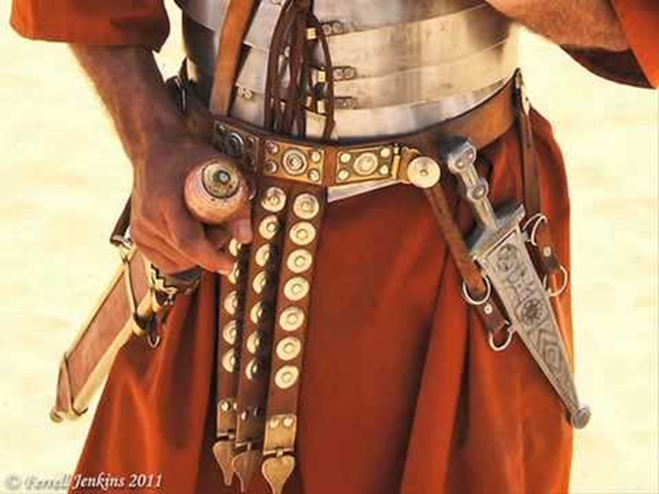
The Belt of Truth
Outfit of the day series (OOTD)

Slide 2
Purpose
Ephesians 6:10-14 Finally, my brethren, be strong in the Lord, and in the power of his might. 11 Put on the whole armour of God, that ye may be able to stand against the wiles of the devil. 12 For we wrestle not against flesh and blood, but against principalities, against powers, against the rulers of the darkness of this world, against spiritual wickedness in high places.13 Wherefore take unto you the whole armour of God, that ye may be able to withstand in the evil day, and having done all, to stand.14 Stand therefore, having your loins girt about with truth, and having on the breastplate of righteousness;

Slide 3
How Does The Truth Function?
Holds things together
Frees us; Affects our Walk (John 8:32)
Teaches Us (John 16:13; John 14:6)
Sanctifies us (John17:17)
Allows us to Reproduce
Allows us to commune with God (John 4:24; Psalm 145:18)
Protects us from Deception (2 Thessalonians 2:10-12)

Slide 4
Discussion Question
Galatians 4:16 Am I therefore become your enemy, because I tell you the truth?
Why is it that some people are unreceptive to truth?

Slide 5
Why Don’t People Receive the Truth?
Requires Change
Abrasive (Cognitive Dissonance)
Fearful
People Pleasing (Relative Truth)
Deceived
Satan Is the Father of Lies (John 8:44)

