Slide 1
The 7 Churches of Revelation
Revelation Chapters 2 & 3

Slide 2
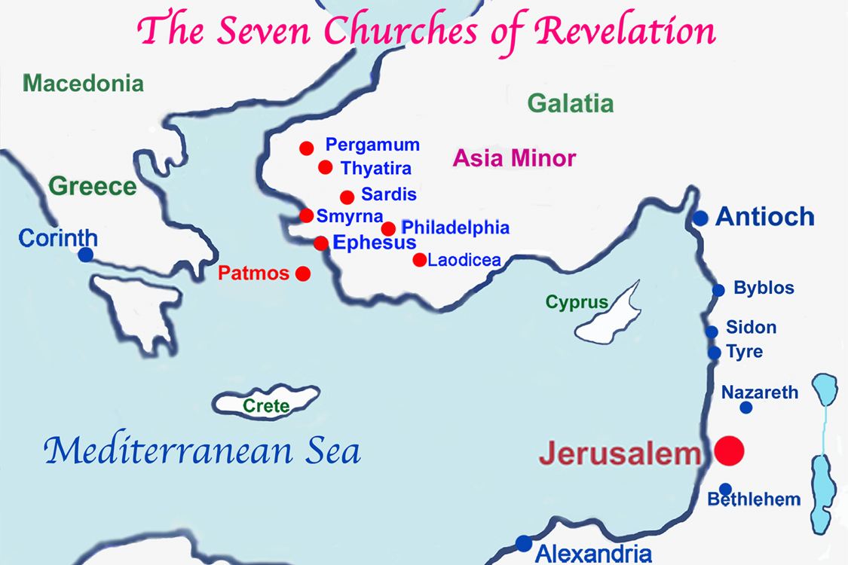
The 7 Churches of Revelation

Slide 3
Ephesus
“These things saith he that holdeth the seven stars in his right hand, who walketh in the midst of the sevel golden candlesticks;”
Pros
Cons
Hates Evil
Tried the spirits
Not Grown Weary
Hates the deeds of the Nicolaitans
Left thy First Love
Consequences: Remove thy candlestick
Promise: The tree of life, in the midst of the paradise of God
Notes: Ephesus is laboring, but left their First Love. Does this represent religious works?

Slide 4
Why Do People Leave Their First Love?
Discussion Question

Slide 5
Smyrna
“These things saith the first and the last, which was dead, and is alive;”
Pros
Cons
Spiritually Rich (Not physically)
Will Go Through Persecution for “10 Days”
None
Consequences: None
Promise: Shall not be hurt of the second death.
Notes: Jesus is aware of fake Jews, “the synagogue of Satan.”

Slide 6
Pergamos
“These things saith he which hath the sharp sword with two edges;”
Pros
Cons
Keeps the Faith Despite Being Located Where Satan’s Great Seat is
Following the Doctrine of Balaam; Eating Things Sacrificed Unto Idols and Fornication
Follow the Nicolaitans
Consequences: Christ will come quickly and fight against them.
Promise: Shall eat of the hidden manna, get a white stone, and receive a new name.
Notes: Antipas was martyred during the time of Nero (54-68) for preaching the gospel casting out demons.
Nicolaitans: One theory is a heretic group of false Christians. Another theory is that it comes from the Greek word Nicolah “let us eat” and promotes licentiousness

Slide 7
Thyatira
“These things saith the Son of God, who hath his eyes like unto a flame of fire, and his feet are like fine brass;”
Pros
Cons
Charity (Love)
Service
Faith
Patience
Works, Humility
Tolerates Jezebel
Fornication
Eat Things Sacrificed unto Idols
Unrepentant
Consequences: Christ will cast her (and those with her) into a bed and kill her children.
Promise: Christ will give him power over the nations, a rod of iron, and the morning star.
Notes: Jezebel taught and seduced Christ’s servants. How do we prevent this seduction?

Slide 8
Sardis
“These things saith he that hath the seven Spirits of God, and the seven stars;”
Pros
Cons
A Few People Have Not Defiled Their Garments
Dead Works (Religious zeal, but Spiritually Dead)
Forgotten and Fallen Away from what they Received and Heard
Consequences: Christ will come like a thief in the night upon them.
Promise: Clothed in white raiment. Name will NOT be blotted out of the book of life, but will confess his name.
Notes: How do we keep our garment clean?

Slide 9
Philadelphia
“These things saith he that is holy, he that is true, he that hath the key of David, he that opened, and no man shutteth; and shutteth, and no man openeth.
Pros
Cons
Has Not Denied Christ
Kept the Word
None Listed
Consequences: None
Promise: Fake Jews will worship before their feet. Will be kept from the hour of temptation. Christ will make them a pillar in the temple of God and write the name of God, the city of God (New Jerusalem), and Christ’s new name.
Notes: Names are significant. They represent authority and identity.

Slide 10
Laodicea
“These things saith the Amen, the faithful and true witness, the beginning of the creation of God;”
Pros
Cons
Has Not Denied Christ
Kept the Word
Lukewarm
Physically Rich but Spiritually Naked
Consequences: Christ will spew them out of his mouth.
Promise: If any man opens the door for Christ, He will come in and dine with them. Christ promises them to sit with him in His throne
Notes: Even though Christ is rebuking many of these churches, it’s out of love.

