Slide 1
The Wedding Garment
Outfit of the Day Series

Slide 2
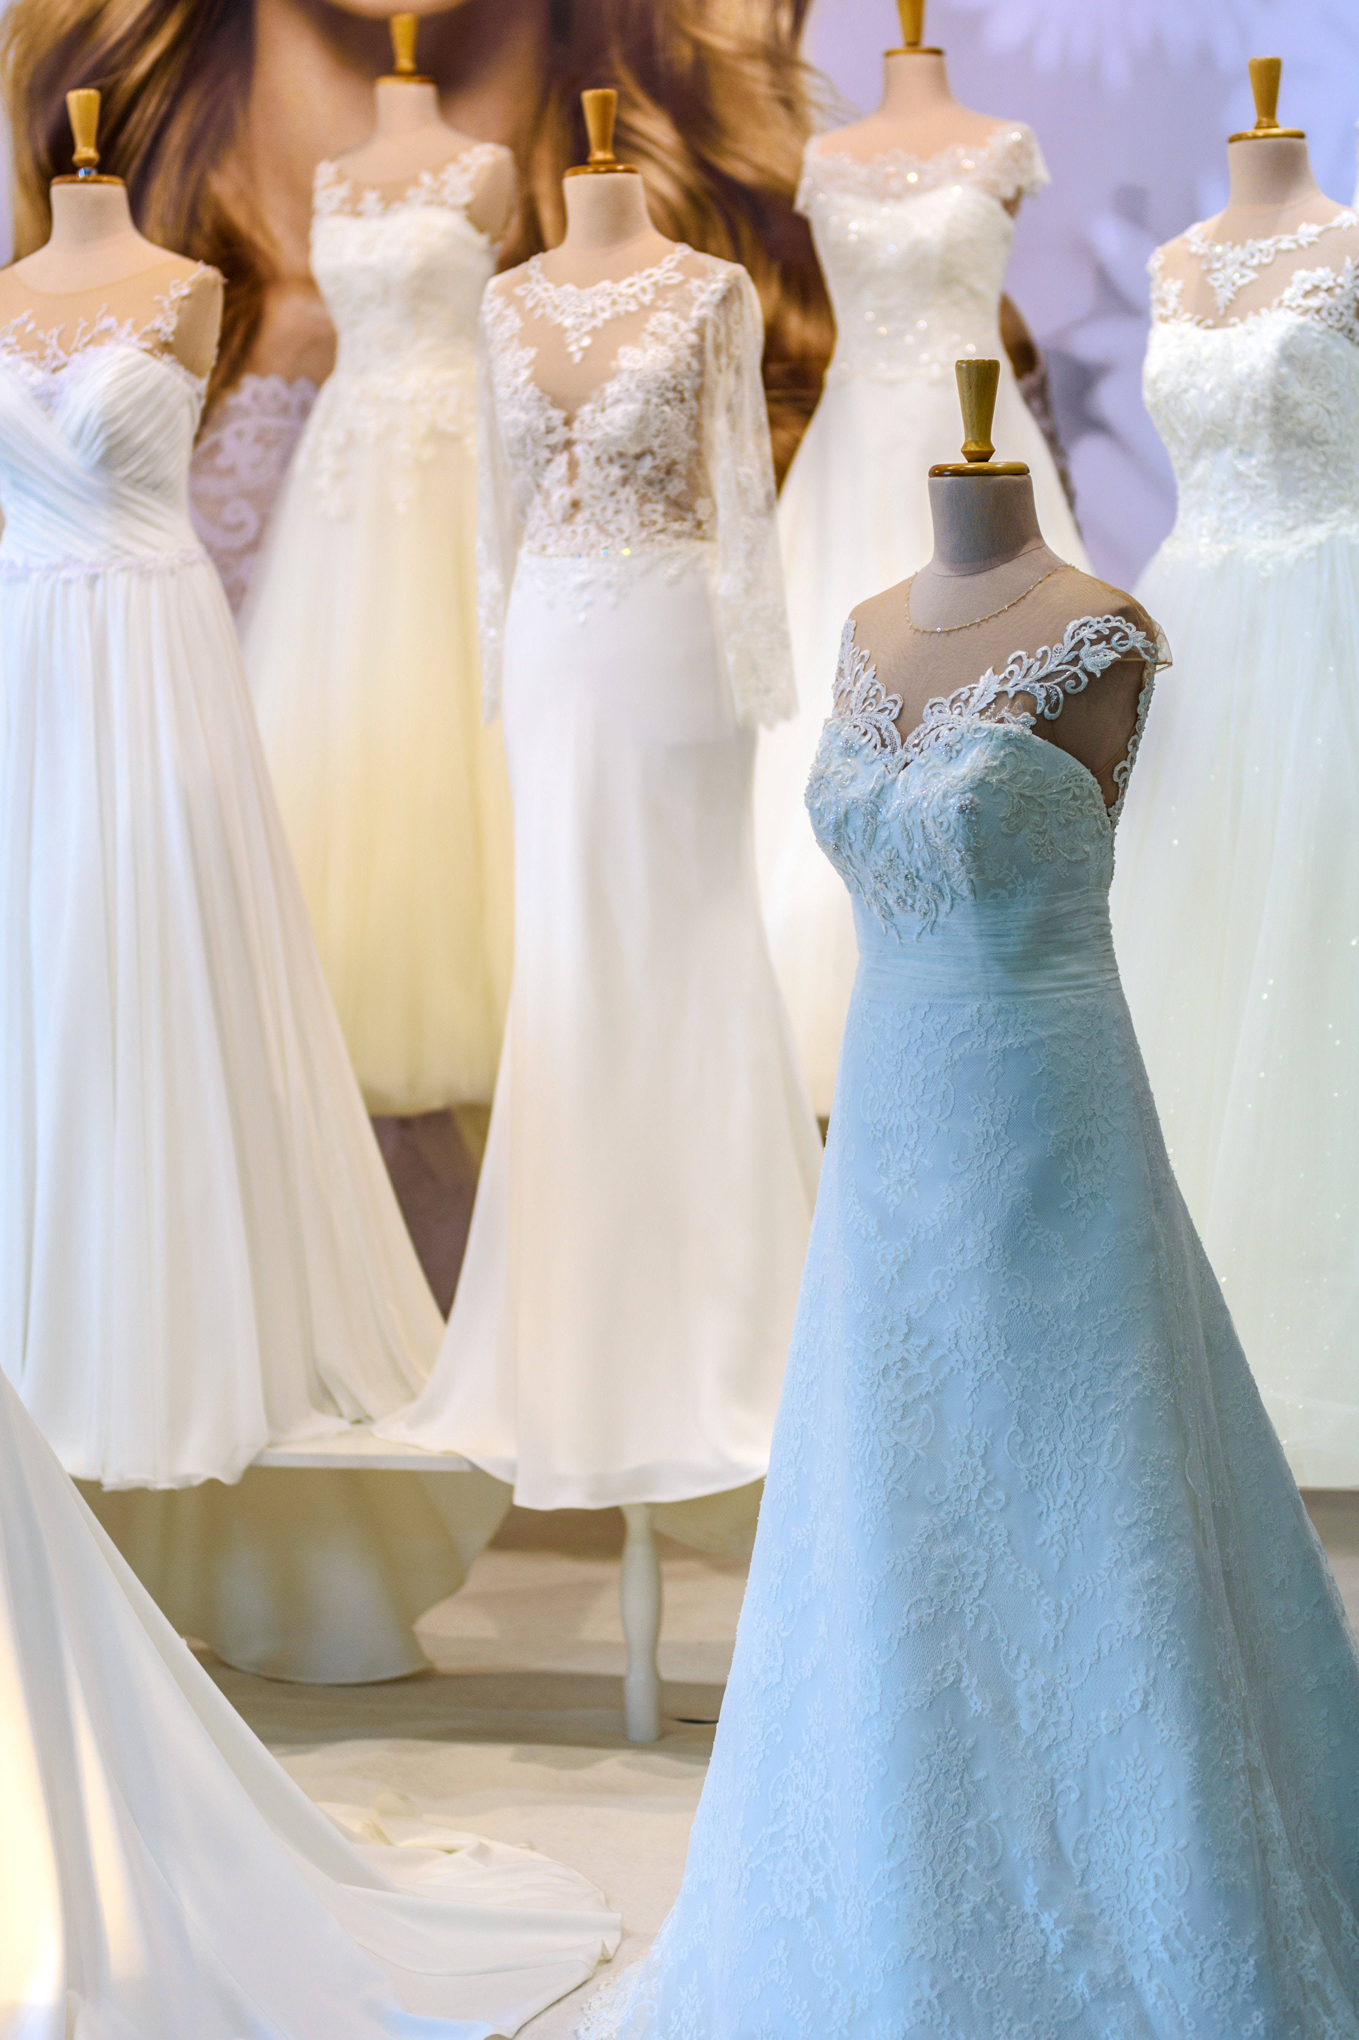
The Bride
Without Spot or Wrinkle (Eph 5:22-33)
Makes Herself Ready (Rev. 19:6-8)
Is Wise (Matthew 25:1-13)
Faithful (2 Corinthians 11:2)
Anticipates (Mark 2:19-20)
Being Sanctified (Esther 2:12)

Slide 3
The Wedding Garment (Matthew 22:2-14)
2 The kingdom of heaven is like unto a certain king, which made a marriage for his son, 3 And sent forth his servants to call them that were bidden to the wedding: and they would not come. 4 Again, he sent forth other servants, saying, Tell them which are bidden, Behold, I have prepared my dinner: my oxen and my fatlings are killed, and all things are ready: come unto the marriage. 5 But they made light of it, and went their ways, one to his farm, another to his merchandise: 6 And the remnant took his servants, and entreated them spitefully, and slew them. 7 But when the king heard thereof, he was wroth: and he sent forth his armies, and destroyed those murderers, and burned up their city.

Slide 4
The Wedding Garment (Matthew 22:2-14)
8 Then saith he to his servants, The wedding is ready, but they which were bidden were not worthy. 9 Go ye therefore into the highways, and as many as ye shall find, bid to the marriage. 10 So those servants went out into the highways, and gathered together all as many as they found, both bad and good: and the wedding was furnished with guests. 11 And when the king came in to see the guests, he saw there a man which had not on a wedding garment: 12 And he saith unto him, Friend, how camest thou in hither not having a wedding garment? And he was speechless. 13 Then said the king to the servants, Bind him hand and foot, and take him away, and cast him into outer darkness, there shall be weeping and gnashing of teeth. 14 For many are called, but few are chosen.

Slide 5
Discussion Question
Why Do People Make Light of Salvation?

Slide 6
The 10 Virgins (Matthew 25:1-13)
1 Then shall the kingdom of heaven be likened unto ten virgins, which took their lamps, and went forth to meet the bridegroom. 2 And five of them were wise, and five were foolish. 3 They that were foolish took their lamps, and took no oil with them: 4 But the wise took oil in their vessels with their lamps. 5 While the bridegroom tarried, they all slumbered and slept. 6 And at midnight there was a cry made, Behold, the bridegroom cometh; go ye out to meet him. 7 Then all those virgins arose, and trimmed their lamps. 8 And the foolish said unto the wise, Give us of your oil; for our lamps are gone out 9 But the wise answered, saying, Not so; lest there be not enough for us and you: but go ye rather to them that sell, and buy for yourselves. 10 And while they went to buy, the bridegroom came; and they that were ready went in with him to the marriage: and the door was shut. 11 Afterward came also the other virgins, saying, Lord, Lord, open to us. 12 But he answered and said, Verily I say unto you, I know you not. 13 Watch therefore, for ye know neither the day nor the hour wherein the Son of man cometh.

Slide 7
Discussion Question
How Do We Get and Keep Oil In Our Lamps?

