Slide 1
Eve Examined
The Art of Serpent Seduction

Slide 2
God’s Purpose for Eve (Gen. 2:15-25)
Genesis 2:21-22 And the Lord God caused a deep sleep to fall upon Adam, and he slept: and he took one of his ribs, and closed up the flesh instead thereof; And the rib, which the Lord God had taken from man, made he a woman, and brought her unto the man.
Adam was sleep when Eve was prepared.
The ribs are for protection, support, and respiration
There are true ribs and false ribs.

Slide 3
The Behavior of Beguilement (Gen. 3:1-5)
Genesis 3:1 Now the serpent was more subtil than any beast of the field which the Lord God had made. And he said unto the woman, Yea, hath God said, Ye shall not eat of every tree of the garden?
God made animals with varying attributes. Satan is strategic in who he chooses.
Eve learned the art of seduction directly from the serpent and used it on Adam.
The spirit of Eve seeks to rehearse the behavior of beguilement (charm, charisma, “game”).
The spirit of Eve also beguiles as well because she takes on the nature of the serpent. Children of disobedience (Colossians 3:5-11)

Slide 4
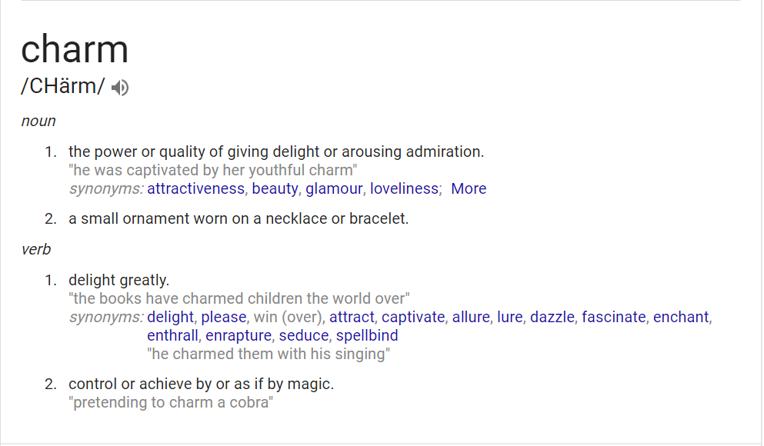
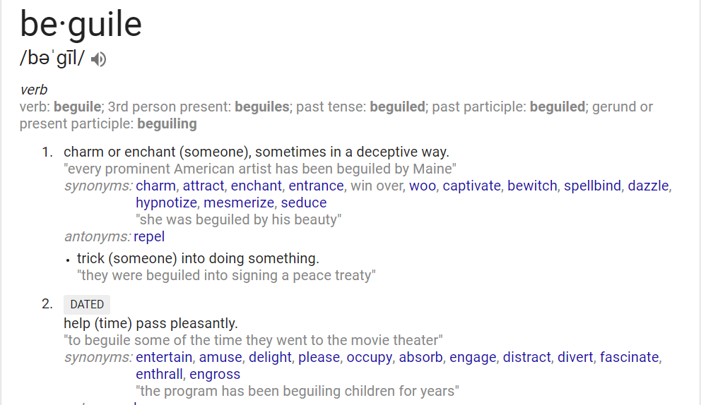
Chasing the Charm

Slide 5
Discussion Question
We are transformed by the renewing of our minds. What has been the hardest part of transformation regarding “human nature”?

Slide 6
The Silly Woman Syndrome (2 Tim. 3:1-6)
Genesis 3:6 And when the woman saw that the tree was good for food, and that it was pleasant to the eyes, and a tree to be desired to make one wise, she took of the fruit thereof, and did eat, and gave also unto her husband with her; and he did eat.
The Serpent crept up to Eve
Eve was guided by her lusts
She learned the word of God, but never came to truth

Slide 7
How to Overcome the Spirit of Eve
Lean not to your own understanding (Proverbs 3:5)
Be a hearer and doer of the word (James 1:22)
Fear the Lord and don’t operate in seduction (Proverbs 31:30)
Submit to God (Ephesians 5:21-24)

Slide 8
3 Takeaways
The Purpose for Eve
Eve was taken from Adam’s rib to be a help meet. The functions of the rib cage is protection, support, and respiration. Adam was sleep and Eve was brought to him with no input of their own.
The Art of Seduction
Eve’s encounter with the serpent made her learn the art of seduction through experience. She rehearsed this with Adam and adopted the fallen, seductive nature of the serpent through sin.
Silly Syndrome
Eve’s disregard for the word of God and following her own lust and understanding resulted in the fall. In order to break this nature, we have to be born again and come to know Truth.

