Slide 1
The Revelation of Weakness
Jacob Examined

Slide 2
Jacob Was an Underdog Battling Rejection (Gen. 25:21-34)
Jacob was inferior to his brother and an underdog from the womb.
Underdog - a competitor thought to have little chance of winning a fight or contest.
Jacob was envious of his brother, Esau, who was the favored child of Isaac and entitled to the birthright. Jacob had been “holding onto his heel” since birth.
The spirit of rejection can fuel us to overcompensate for weaknesses through manipulation. Jacob gravitated to his mother by default and learned the art of manipulation to even the scales.

Slide 3
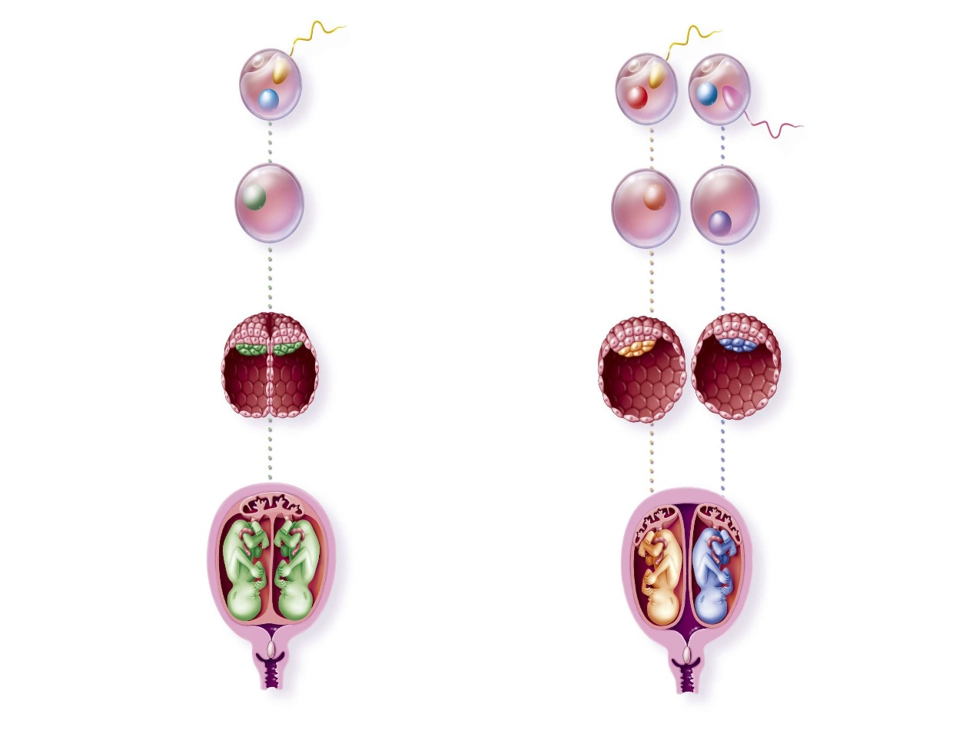
Identical vs. Fraternal Twins
Fraternal twins (dizygotic) come from a hyper-ovulating mother
They have separate genes and are no more related than siblings.
Fraternal twins have increased recently with fertility treatments.
Certain populations have higher instances; such as older mothers or Central African populations.
Identical (Monozygotic) Twins (1 Sperm; 1 egg)
Fraternal (Dizygotic) Twins (2 Sperm; 2 eggs)
Splits into two in shared placenta
Separate placentas
Share all of their genes
Share about half of their genes

Slide 4
The Consequences of Shortcuts (Gen. 27)
Seeking acceptance outside of God can lead us to go through drastic and ruthless measures.
Satan will always provide a shortcut to get what you want. Jacob’s shortcut was to use subtility, which is the primary nature of the serpent. (v. 35)
Jacob’s entire identity was driven by his desire to supplant Esau. Supplant means to supersede and replace. (v. 36)
Choosing ungodly route to success always come with repercussion. Esau was so upset with Jacob’s cutthroat ways that he vowed to kill him. (v. 41)
Jacob’s antics revealed deeper layers of Esau’s character. Esau would have been better served taking the high road, but instead got vengeful, and married a rejected woman to find favor with His father.

Slide 5
Discussion Question
How are you able to resist the shortcuts in life and do things God’s way instead?

Slide 6
Jacob Began to Reap What He Sowed
When we act outside of the will of God, we set ourselves up reap from the negativity that we have sown.
Jacob was promised Rachel as a wife by Laban if he worked 7 years for her. He was given Leah instead and had to work an additional 7 years for Rachel. (Gen 29:15-28)
Leah’s rejection made her try to work for the love of Jacob. (Gen 29:30-35)
Rachel (younger sister) began to envy Leah because she had not had children. This is a parallel to Jacob envying his older brother, Esau. (Gen. 30:1-8)
Jacob was living in fear to return home from what he did to Esau.

Slide 7
Brokenness Comes Before the Blessing (Gen. 32:24-32)
Jacob wrestled and had to become broken in order to receive a blessing.
God had to make Jacob new in order for him to walk in his blessing.
Jacob gained the revelation that the only true blessing and approval that matters is from God and not from man or his earthly father. He could now hold onto the Lord, instead of Esau’s heel. (Eph. 2:6)
Jacob saw God face to face and died and became Israel.
Jacob's brokenness was a perpetual state for the rest of his life. God took away the smooth, slick, and subtil ways of Jacob.

Slide 8
God Delights in Humility
Christ came for the sick (Mark 2:17)
God uses the foolish things to confound the wise (1 Cor. 1:18-31)
God resists the proud and gives grace to the humble (James 4:6-7; 1 Pet. 5:5-6)
Blessed are the… (Matthew 5:3-11)
The least shall be the greatest(Luke 9:46-48)
Lazarus and the rich man (Luke 16:19-31)
Jesus was sent to display the beauty of meekness (Isaiah 53:2)

Slide 9
Jesus’ Strength is Made Perfect in Weakness (2 Cor 12:1-10)
It is not expedient for me doubtless to glory. I will come to visions and revelations of the Lord. I knew a man in Christ above fourteen years ago, (whether in the body, I cannot tell; or whether out of the body, I cannot tell: God knoweth;) such an one caught up to the third heaven. And I knew such a man, (whether in the body, or out of the body, I cannot tell: God knoweth;) How that he was caught up into paradise, and heard unspeakable words, which it is not lawful for a man to utter. Of such an one will I glory: yet of myself I will not glory, but in mine infirmities. For though I would desire to glory, I shall not be a fool; for I will say the truth: but now I forbear, lest any man should think of me above that which he seeth me to be, or that he heareth of me. And lest I should be exalted above measure through the abundance of the revelations, there was given to me a thorn in the flesh, the messenger of Satan to buffet me, lest I should be exalted above measure. For this thing I besought the Lord thrice, that it might depart from me. And he said unto me, My grace is sufficient for thee: for my strength is made perfect in weakness. Most gladly therefore will I rather glory in my infirmities, that the power of Christ may rest upon me. Therefore I take pleasure in infirmities, in reproaches, in necessities, in persecutions, in distresses for Christ's sake: for when I am weak, then am I strong.

Slide 10
3 Takeaways
Jacob’s Rejection
Jacob was not favored by his earthly father being the youngest and also less brutish of the twin brothers. This fueled him into manipulation to even the scales in his own eyes.
Jacob’s Life Playing Out
Jacob began to reap the consequences of his manipulation when he was swindled into working 7 additional years for Rachel. He also saw drama play out between Rachel and Leah.
The Blessing of Brokenness
Jacob wrestled with God like he did with Esau and like Rachel did with Leah. However, Jacob received the revelation of brokenness in that the one who is weak before God is truly blessed.

