Slide 1
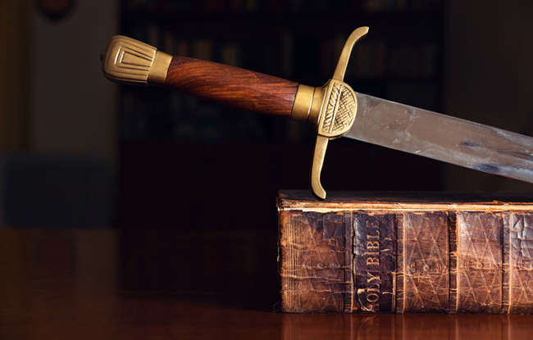
The Sword of the Spirit
Outfit of the day series (OOTD)

Slide 2
Discussion Question
Can you think of a time of when you’ve used the Word of God as a weapon?

Slide 3
The Roman Sword (Gladius)
Ephesians 6:17 And take the helmet of salvation, and the sword of the Spirit, which is the word of God:
Close Range Combat
Dual Edges / Tapered Point
Offensive / Defensive
Supernatural Word

Slide 4
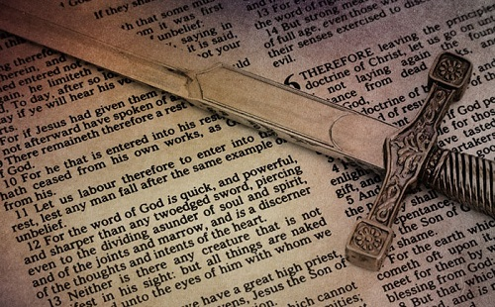
The word
Rhema Word (2 Timothy 3:16-17)
Alive (Hebrews 4:12)
Infallible
Effective (Isaiah 55:10-11)
Offensive / Defensive

Slide 5
Discussion Question
Who or What are we fighting with our sword?

Slide 6
What are we fighting?
Soul/Spirit, Joints/Marrow, Thoughts/Intensions (Luke 10:27)
Unrighteousness (2 Timothy 3:16-17)
Wiles - devious or cunning stratagems employed in manipulating or persuading someone to do what one wants.
Other swords

Slide 7
Swordsmanship
The Garden of Eden (Genesis 3)
Jesus Tempted in the Wilderness (Luke 4/Matthew 4)
The 7 Sons of Sceva (Acts 19:11-20)
Jesus teaching in the Synagogue (Mark 1:22; Matthew 7:28-29)

Slide 8
Discussion Question
What are some attacks on the Word of God today?

