Slide 1
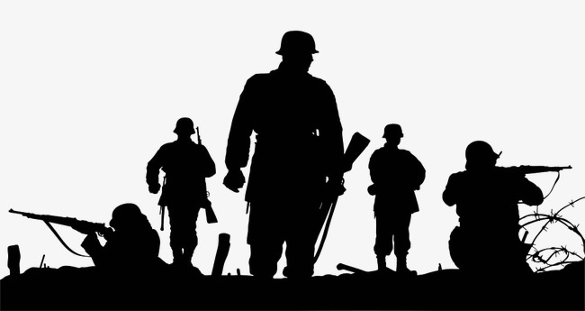
Overcoming Fear and Anxiety
Spiritual Warfare Series

Slide 2
False Evidence Appearing Real
Fear - an unpleasant emotion caused by the belief that someone or something is dangerous, likely to cause pain, or a threat.
Heb 11:1 Now faith is the substance of things hoped for, the evidence of things not seen. Fear is the complete opposite of faith, belief in danger.
Anxiety - a feeling of worry, nervousness, or unease, typically about an imminent event or something with an uncertain outcome.
Fear’s seeks to paralyze. It comes in many forms: fear of man, fear of failure, fear of death, etc.
Anxiety is causes by a lack of faith, patience, contentment, leaning to our own understanding, and a lack of relationship with the LORD. (Phil. 4:6-7)

Slide 3
Peter Then… (Luke 22)
Luke 22:31-34 And the Lord said, Simon, Simon, behold, Satan hath desired to have you, that he may sift you as wheat: But I have prayed for thee, that thy faith fail not: and when thou art converted, strengthen thy brethren. And he said unto him, Lord, I am ready to go with thee, both into prison, and to death. And he said, I tell thee, Peter, the cock shall not crow this day, before that thou shalt thrice deny that thou knowest me.
Sift is a strong shaking. Fear comes to shake our faith. In order not to be sifted, we have to hold onto to Christ.
Fear (in essence) is denial of the Lord. It’s denial of Him being a protector, provider, deliverer, healer, etc. (Heb. 11:6)
Fear is driven by self-preservation.

Slide 4
Peter Now (Acts 4)
Acts 4:13 Now when they saw the boldness of Peter and John, and perceived that they were unlearned and ignorant men, they marvelled; and they took knowledge of them, that they had been with Jesus.
Peter’s boldness came from the resurrection power of the Holy Ghost (v. 8)
The different between Peter then and Peter now was that Jesus defeated death and the grave. (Rev. 1:18; Heb. 2:15)
When Jesus resurrected, it validated all of his experience. (John 14:11)
Peter was now living through selflessness (love) and not self preservation. He had faith in his commission.
The great commission is founded on the basis that Jesus has been given all power. (Matt. 28:18-20)

Slide 5
Peter Moving Forward
Galatians 2:11-12 But when Peter was come to Antioch, I withstood him to the face, because he was to be blamed. For before that certain came from James, he did eat with the Gentiles: but when they were come, he withdrew and separated himself, fearing them which were of the circumcision.
The approval of man or those we esteem can be the biggest challenge of fear. (Matt. 10:33)
Peter’s initial boldness was right after the day of Pentecost. We have to continue to stir up the gift that is within us.
Fear is designed to compromise and not confront.
Overcoming fear requires endurance. Peter had faith to step out on the water, but not faith that endures. (Matt. 14:28-31)

Slide 6
Discussion Question
Why is fear of man such a challenge for people?

Slide 7
3 Takeaways
Fear and anxiety are simply feelings or emotions that we experience that are not real. We have a choice to believe in the Word of God or in what we see with our circumstances. Focusing on God and not our situation is key.
Peter was someone who experienced fear when he denied knowing Jesus. After Jesus’ resurrection and conquering of death, Peter had renewed faith and Holy Ghost power that he received at Pentecost.
Even with all his strides, Peter still dealt with the fear of man. Sometimes our biggest idols can be those that we revere the most. To conquer this, we must have a focus on God and an enduring faith that lasts until the end.

