Slide 1


The Heart Check
The Operation Series

Slide 2

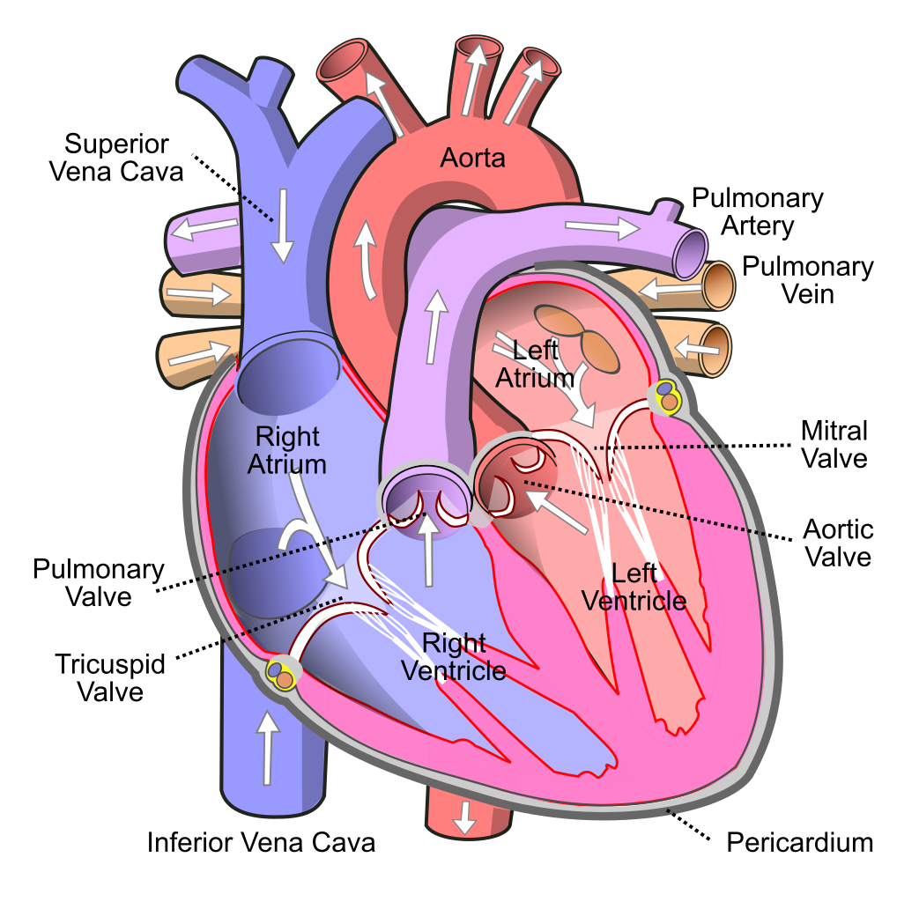

The Human Heart
The human heart is an organ that pumps blood throughout the body via the circulatory system, supplying oxygen and nutrients to the tissues and removing carbon dioxide and other wastes
60-100 bpm; 2000 gallons/day; beats 100k/day, 35 mil/year
Has 4 chambers, divided left and right sides, separates oxygen rich blood from oxygen poor blood. (Gen. 2:7)
Heart has electrical wiring which keeps it breathing
Blockages of the arteries cause a heart attack (spiritual cholesterol)
If you were to stretch out your blood vessel system, it would extend over 60,000 miles.
James 1:13-15 Let no man say when he is tempted, I am tempted of God: for God cannot be tempted with evil, neither tempteth he any man: But every man is tempted, when he is drawn away of his own lust, and enticed. Then when lust hath conceived, it bringeth forth sin: and sin, when it is finished, bringeth forth death.

Slide 3
Characteristics of the Heart
Hiding Place:
  Psalm 119:11 Thy word have I hid in mine heart, that I might not sin against thee.
Meditates:
  Psalm 19:14 14 Let the words of my mouth, and the meditation of my heart, be acceptable in thy sight, O Lord, my strength, and my redeemer.
  Hebrews 4:12 12 For the word of God is quick, and powerful, and sharper than any twoedged sword, piercing even to the dividing asunder of soul and spirit, and of the joints and marrow, and is a discerner of the thoughts and intents of the heart.
  Matthew 15:18-20 But those things which proceed out of the mouth come forth from the heart; and they defile the man. For out of the heart proceed evil thoughts, murders, adulteries, fornications, thefts, false witness, blasphemies: These are the things which defile a man: but to eat with unwashen hands defileth not a man.
Houses the blood / soul
  Genesis 4:10 And he said, What hast thou done? the voice of thy brother's blood crieth unto me from the ground.
Proverbs 2:2 So that thou incline thine ear unto wisdom, and apply thine heart to understanding;

Slide 4

God’s Will For Us
Ezekiel 36:24-28
24 For I will take you from among the heathen, and gather you out of all countries, and will bring you into your own land.
25 Then will I sprinkle clean water upon you, and ye shall be clean: from all your filthiness, and from all your idols, will I cleanse you.
26 A new heart also will I give you, and a new spirit will I put within you: and I will take away the stony heart out of your flesh, and I will give you an heart of flesh.
27 And I will put my spirit within you, and cause you to walk in my statutes, and ye shall keep my judgments, and do them.
28 And ye shall dwell in the land that I gave to your fathers; and ye shall be my people, and I will be your God.
Heart Surgery
Matthew 5:8 Blessed are the pure in heart: for they shall see God.

Slide 5

Discussion Question
How Do You Guard Against Your Heart?
Proverbs 4:23 Keep thy heart with all diligence; for out of it are the issues of life.

Slide 6
Tips for Good
Heart Health
1. Healthy Diet / Avoid Processed Foods: Phil. 4:8; 2 Tim. 4:3
Heart Disease in the US (CDC)
About 610k people die of heart disease in the US. ¼ deaths
Leading cause of death for men and women
Heart disease 370k; 735k heart attack – 525k first; 210K already
Chest pain, discomfort in limbs and , shortness of breath, nausea cold sweats
Only 27% knew to call 911; 47% deaths outside of hospital
Most heart attacks occur on a Monday
Christmas Day is most common day for heart attacks
2. Avoid Smoking / Second Hand: Eph. 2:2; 1 Cor. 15:33
3. Keep an active Lifestyle / 30 mins activity: Jas. 2:14: Matt. 26:40
4. Healthy Body Weight (Portion Control): 1 Cor. 10:23; Luk. 10:42
5. Reduce you stress: Matt. 11:28-30; 1 Pet. 5:7; Pro. 12:25
Bonus: Visit with your doctor regularly: Heb. 4:16; Ps. 16:11: Ps. 27:8

Slide 7

Three Takeaways
The Heart Check (The Operation Series)
God Breathed
Heart Surgery
Heart Health
The human heart is an organ that pumps blood throughout the body. It has two chambers that filter oxygen poor blood and oxygen rich blood. The breath of God is the Spirit of God, which is the vitality of a believer. The heart has characteristics and is the housing place for our mind, will, and emotions.
The ministry of the gospel is reconciliation. Those with pure hearts will see God. For this reason, God desires to take out our stony wicked heart and give us a heart of flesh. A heart of flesh means that the blood of Christ is able to flow freely and regenerate us into sons and daughters of God. We can’t avoid surgery because it’s out only hope.
In order to have a healthy heart, we must practice good spiritual diet and exercise. This means being sanctified and active in ministry. Reducing stress is also vital to our walk with the LORD because scripture tells us not to be anxious about anything. Regular “check-ups” with the LORD can ensure that we remain in good health.

