Slide 1
Victory Over the Flesh
The Operation Series

Slide 2
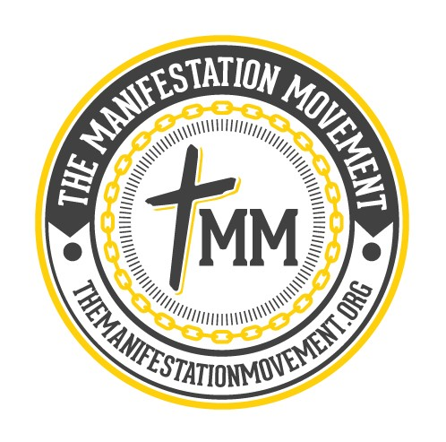
The Will
God’s Will: Eternal Life through Faith in Jesus Christ
Our Will: ??? Choose this day whom ye will serve
Satan’s Will: Steal, Kill, Destroy
The soul is comprised of the mind, will, and emotions. We choose our will.
God’s will for us is that none should perish (2 Pet. 3:9).
Satan’s strategy is to manipulate us to choose our own will (Garden of Eden).
Contrary to popular belief, false liberation and self worship is Satan’s mantra. Thelema.
The lust of the flesh is a factor in making us self-willed.
James 1:13-15 Let no man say when he is tempted, I am tempted of God: for God cannot be tempted with evil, neither tempteth he any man: But every man is tempted, when he is drawn away of his own lust, and enticed. Then when lust hath conceived, it bringeth forth sin: and sin, when it is finished, bringeth forth death.

Slide 3
The Flesh
The flesh operates in a fallen nature because it is absent the Spirit of God. (Gal. 5:19-21)
Being absent of God means that the flesh does not function in truth, but feelings and pleasures. (2 Thess. 2:10-12; 2 Tim. 3:1-5)
The bible refers to it as “mortality” and “corruptible”. (1 Corinthians 15:53-55)
The flesh wrestles against the Spirit because it is fighting for survival and self preservation.
God sovereignly designed it so that the works of the flesh cannot sustain us.
Galatians 5:16-17 This I say then, Walk in the Spirit, and ye shall not fulfil the lust of the flesh. For the flesh lusteth against the Spirit, and the Spirit against the flesh: and these are contrary the one to the other: so that ye cannot do the things that ye would.

Slide 4
Discussion Question
How do you keep your flesh under control?
1 Corinthians 9:27 But I keep under my body, and bring it into subjection: lest that by any means, when I have preached to others, I myself should be a castaway.

Slide 5
How Do We Overcome The Flesh?
3 Strategies
Just Say “No”
Be Set Apart
Fasting & Prayer
Psalm 69:10 When I wept, and chastened my soul with fasting, that was to my reproach.
Mark 9:29 And he said unto them, This kind can come forth by nothing, but by prayer and fasting.
Luke 21: 19 In your patience possess ye your souls.
Galatians 5:16 This I say then, Walk in the Spirit, and ye shall not fulfil the lust of the flesh.
Luke 9:23 And he said to them all, If any man will come after me, let him deny himself, and take up his cross daily, and follow me.
Proverbs 4:23 Keep thy heart with all diligence; for out of it are the issues of life.
2 Peter 2:7-8 And delivered just Lot, vexed with the filthy conversation of the wicked: (For that righteous man dwelling among them, in seeing and hearing, vexed his righteous soul from day to day with their unlawful deeds;)

Slide 6
Three Takeaways
The Flesh (The Operation Series)
The Battle for the Will
The Fallen Flesh
Victory over the Flesh
The battle is for our souls. Our will determines our eternal resting place. We have a choice to chose God’s will for our life, be self-willed, or Satan’s will. Contrary to popular belief, Satan’s will for our lives is simply that we follow our own will, not to worship him. False liberation through the lust of the flesh is the catalyst.
The flesh does not function in truth. It uses feelings and pleasure to suggest an alternative way of sustenance instead of the Spirit of God. The flesh provides a temporal feeling of life, but only God can provide eternal life. The flesh wants people to choose it through the power of suggestion, which started in the Garden.
We can keep our flesh under subjection through prayer and fasting, denying our flesh, and being sanctified. We have a responsibility to chose where we want to walk. Our meditation has to be on good things. Whatever we put in is what we’ll get out. The more we are set apart, the more God can purge us of any wickedness.

