Slide 1
I heard it through the Grapevine
Walking In Your Purpose

Slide 2
The True Vine (John 15:1-8)
I am the true vine, and my Father is the husbandman. Every branch in me that beareth not fruit he taketh away: and every branch that beareth fruit, he purgeth it, that it may bring forth more fruit. Now ye are clean through the word which I have spoken unto you. Abide in me, and I in you. As the branch cannot bear fruit of itself, except it abide in the vine; no more can ye, except ye abide in me. I am the vine, ye are the branches: He that abideth in me, and I in him, the same bringeth forth much fruit: for without me ye can do nothing. If a man abide not in me, he is cast forth as a branch, and is withered; and men gather them, and cast them into the fire, and they are burned. If ye abide in me, and my words abide in you, ye shall ask what ye will, and it shall be done unto you. Herein is my Father glorified, that ye bear much fruit; so shall ye be my disciples.

Slide 3
Facts About Grapevines
“When it comes to pruning grapes, the most common mistake people make is not pruning hard enough. Light pruning doesn’t promote adequate fruiting whereas heavy pruning provides the greatest quality of grapes.” (Heb. 4:12)
“When pruning grapes, you’ll want to cut off as much of the old wood as possible. This will encourage the growth of new wood, which is where the fruit is produced.” (Eph. 4:22-24)
“Without human intervention, grapevines will naturally grow into a bushy-tree-like mess of leaves and branches. Meticulous pruning and training help the vines stay nice and organized, and focus their energy on growing impeccable grapes.” (Isa. 64:6)
“The first year of growth in a vine’s life is meant to build up nutrient stores, just like when we’re told as kids to eat our spinach so we grow up big and strong. Any flower clusters that grow are usually cut back, so that the vine can focus its energy on establishing a strong root system. Producing fruit so early on is a lofty goal, to the vine’s detriment; as is said, we should learn to walk before we run.” (1 Pet. 2:2; 1 Tim. 3:6)
*Sources: Gardeningknowhow.com; winefolly.com

Slide 4
Facts About Grapevines
The prior year’s canes are cut back and the pruner chooses the best canes to grow new shoots for the coming year’s harvest. (Matt. 24:14)
During April/May (Sept/Oct in the Southern Hemisphere) the first signs of life occur, sap rises up and the buds begin to break. The buds are extremely delicate during this time, for spring hailstorms can destroy them. (Matt. 13:3-9)
After the buds break in early spring, they continue to grow. Some viticulturists prune the downward facing shoots to ensure that all the shoots grow upward and to reduce the potential crop size. This strategy involves reducing quantity to increase quality because vines that produce limited numbers of grapes produce more concentrated grapes. (Jdg. 7:2)
The flowers of grapevines are called perfect flowers: they pollinate themselves without the need of bees. (Ps. 1:1)
Just before vérasion begins, some wine growers do green harvesting, wherein a little excess weight is removed from the vines (the superficial grape bunches) so that the vines can focus their energy on their real friends. Er, grapes, focus on their remaining grapes. (Ps. 55:22)
*Sources: winefolly.com

Slide 5
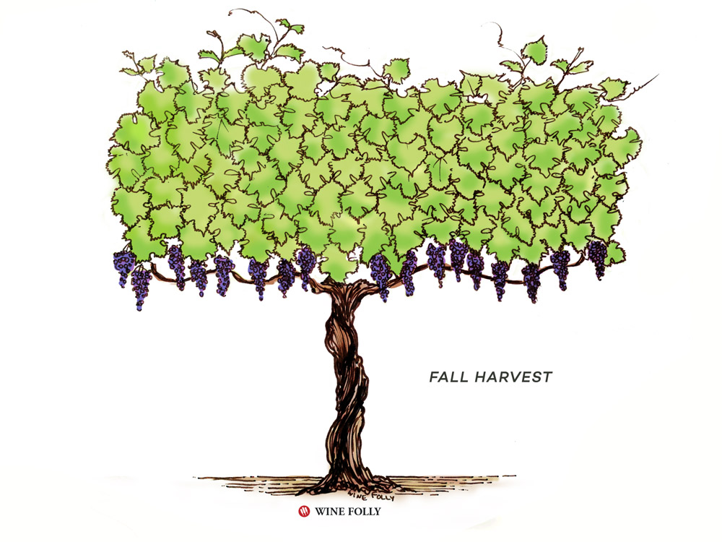
Some Things to Consider
There are several ways to bear fruit. Do not be fixated on tangible and glorified roles.
Sometimes God will give you your destiny in pieces so that it is developed in his perfect timing.
Some of our life experiences can be used for God’s glory. (e.g. Paul’s knowledge of the law. Joseph’s dreams in prison. Daniel’s interpretations; David’s shepherding, etc.)
Our ability to produce means we have to have a healthy balance of consumption and production. God will not reveal our full purpose until we avail ourselves to be able to produce for Him. Putting away distractions. (Luke 12:48)

Slide 6
What are effective ways to put away distractions?
Discussion Question

Slide 7
3 Takeaways
Hearing it through the grapevine
The Breaking
Know Your Role
Our purpose is revealed through our connection to Christ. The only way that we can produce fruit is to be connected to the True Vine. God takes us through a very meticulous pruning process for us to be productive. Much of this process is removal of old and dead things
Before harvest occurs, there has to be an outpour and a breaking. The sacrifices of God are a broken spirit and a contrite heart. Only from that place are we ready to be used by God. The goal of God’s harvest quality over quantity. God is not moved by numbers.
Our purpose may not always be glamorous. We have to be available for God to use us in His kingdom how He sees fit. Everything must be done in God’s timing. To be an effective vessel, we have to consume from the Lord (and not other sources) and produce at a high level.

