Slide 1
Personal convictions vs. universal convictions
The New Covenant

Slide 2
Discussion Question
Do you believe God works through personal or universal convictions? Why?

Slide 3
Luke 18:18-30 “The Rich Young Ruler”
And a certain ruler asked him, saying, Good Master, what shall I do to inherit eternal life? 19 And Jesus said unto him, Why callest thou me good? none is good, save one, that is, God. 20 Thou knowest the commandments, Do not commit adultery, Do not kill, Do not steal, Do not bear false witness, Honour thy father and thy mother. 21 And he said, All these have I kept from my youth up. 22 Now when Jesus heard these things, he said unto him, Yet lackest thou one thing: sell all that thou hast, and distribute unto the poor, and thou shalt have treasure in heaven: and come, follow me. 23 And when he heard this, he was very sorrowful: for he was very rich. 24 And when Jesus saw that he was very sorrowful, he said, How hardly shall they that have riches enter into the kingdom of God! 25 For it is easier for a camel to go through a needle's eye, than for a rich man to enter into the kingdom of God. 26 And they that heard it said, Who then can be saved? 27 And he said, The things which are impossible with men are possible with God. 28 Then Peter said, Lo, we have left all, and followed thee. 29 And he said unto them, Verily I say unto you, There is no man that hath left house, or parents, or brethren, or wife, or children, for the kingdom of God's sake, 30 Who shall not receive manifold more in this present time, and in the world to come life everlasting.

Slide 4
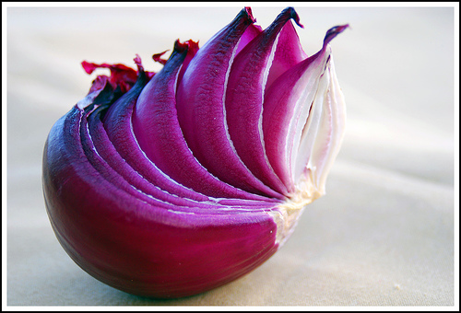
Personal Convictions
Personal convictions are designed to remove our dependencies. (unload)
Personal convictions are designed to expose idols.
Oftentimes, we are broken and then broke-in by the LORD. (Gen 32:24-28)
Old mindsets/strongholds from the world need to be broken out of us to renew our minds and live as a new creation.
Anything that is definitive in scripture applies to the life of a believer (2 Tim. 3:16-17)
The epistles that provide our present day doctrine were inspired by the Holy Spirit.
Some things may not be explicitly listed in scripture. However, they may be covered. E.g. not defiling your temple; not fashioning yourself after the world; uncleanness, etc.

Slide 5
The Letter vs. The Spirit
Living by the Letter
Living by the Spirit
Defined restrictions (limited/temporal)
Common rules (works)
Glorifies man’s merit
A glimpse of the character of God
Not made for a righteous man (fallen nature)
Sin conscious
100% living sacrifice (eternal) (Gen 22:2)
Personal guidance (faith)
Glorifies a work that only God can do (Eph. 2:8)
Unlimited revelation of the character of God
Made righteous so no law needed (Godly nature)
God conscious (Titus 1:15)

Slide 6
2 Corinthians 3:3-18
3 Forasmuch as ye are manifestly declared to be the epistle of Christ ministered by us, written not with ink, but with the Spirit of the living God; not in tables of stone, but in fleshy tables of the heart. 4 And such trust have we through Christ to God-ward: 5 Not that we are sufficient of ourselves to think any thing as of ourselves; but our sufficiency is of God; 6 Who also hath made us able ministers of the new testament; not of the letter, but of the spirit: for the letter killeth, but the spirit giveth life. 7 But if the ministration of death, written and engraven in stones, was glorious, so that the children of Israel could not stedfastly behold the face of Moses for the glory of his countenance; which glory was to be done away: 8 How shall not the ministration of the spirit be rather glorious? 9 For if the ministration of condemnation be glory, much more doth the ministration of righteousness exceed in glory. 10 For even that which was made glorious had no glory in this respect, by reason of the glory that excelleth. 11 For if that which is done away was glorious, much more that which remaineth is glorious. 12 Seeing then that we have such hope, we use great plainness of speech: 13 And not as Moses, which put a veil over his face, that the children of Israel could not stedfastly look to the end of that which is abolished: 14 But their minds were blinded: for until this day remaineth the same vail untaken away in the reading of the old testament; which vail is done away in Christ. 15 But even unto this day, when Moses is read, the vail is upon their heart. 16 Nevertheless when it shall turn to the Lord, the vail shall be taken away. 17 Now the Lord is that Spirit: and where the Spirit of the Lord is, there is liberty. 18 But we all, with open face beholding as in a glass the glory of the Lord, are changed into the same image from glory to glory, even as by the Spirit of the Lord.

Slide 7
4 Ways to Stay Anchored
WHY? What are the reasons for your desires? What is the inspiration?
Why do you want to wear make up, to wear cologne, to have a luxury car, wear a weave, to have designer handbags, etc.?
Trust and don’t quench the unction of the Holy Ghost (Jn. 14:26; 1 Thess. 5:19)
Test the spirits in all things. (1 John 4:1-6)
Exercise wisdom (1 Cor. 10:23)

