Slide 1
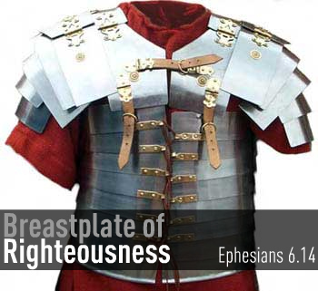
The Breastplate of Righteousness
Outfit of the day series (OOTD)

Slide 2
Purpose
Ephesians 6:10-14 Finally, my brethren, be strong in the Lord, and in the power of his might. 11 Put on the whole armour of God, that ye may be able to stand against the wiles of the devil. 12 For we wrestle not against flesh and blood, but against principalities, against powers, against the rulers of the darkness of this world, against spiritual wickedness in high places.13 Wherefore take unto you the whole armour of God, that ye may be able to withstand in the evil day, and having done all, to stand.14 Stand therefore, having your loins girt about with truth, and having on the breastplate of righteousness;

Slide 3
What Is Righteousness?
DIKAIOSUNE – The character or quality of being right or just
Attribution of God (e.g. his faithfulness, truthfulness, character)
“of that gracious gift of God to men whereby all who believe on the Lord Jesus Christ are brought into right relationship with God”

Slide 4
Function
Made of all Metal
Protects the Front of the Soldier (not the back)
Not expected to retreat
Other Soldiers were supporting the back
Lightweight / allowed for speed, agility, and stamina
Protects Vital Organs (heart, lungs, liver, etc.)

Slide 5
How Do We Put on Righteousness?
Pray it on
Must Be Our Nature; Born into it (1 John 2:29)
Abide in Christ (2 Corinthians 5:21)
Submission (Romans 10:1-4)
Believe With the Heart (Romans 10:5-10)
Walk After the Spirit (Romans 8:1-8)

Slide 6
The Importance of the Heart
Proverbs 4:23 - Keep thy heart with all diligence; for out of it are the issues of life.
Matthew 5:8 - Blessed are the pure in heart: for they shall see God.
Proverbs 21:2 - Every way of a man is right in his own eyes: but the LORD pondereth the hearts.
1 Timothy 1:5 - Now the end of the commandment is charity out of a pure heart, and of a good conscience, and of faith unfeigned:
Jeremiah 17:10 - I the LORD search the heart, I try the reins, even to give every man according to his ways, and according to the fruit of his doings.
Luke 10:27 - And he answering said, Thou shalt love the Lord thy God with all thy heart, and with all thy soul, and with all thy strength, and with all thy mind; and thy neighbour as thyself.

Slide 7
Discussion Question
What are some of the attacks we face that come against our breastplate of righteousness?

Slide 8
Attacks We Face
Hearing and Seeing (Lot)
Lies
Temptation
Demoralization

