Slide 1
Fasting and Prayer
Spiritual Weapons

Slide 2
What is Fasting?
Abstinence from food
A spiritual Discipline
Between You and God (Matthew 6:16-18)
Corporate (Esther 4:16)
An expectation of God (Mark 2:18-20)
Expression of Dependency
Sacrifice/contrition (Joel 1:14; Joel 2:12)
A Solicitation (Not a magic wand) (Isaiah 58:1-4)
Preparation (Matthew 4:1-4)

Slide 3
Discussion Question
What benefits have you gained from fasting?

Slide 4
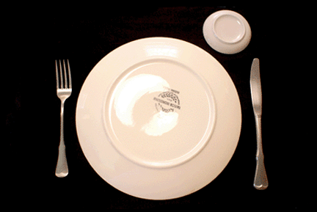
What are the benefits
Mastery of the flesh/Soul (Psalms 69:10)
Draw closer to God (exodus 34:28)
Heightened spiritual senses
Physical healing
Mental clarity
Deliverance
victory

Slide 5
“This Kind”
Mark 9:14-29 And when he came to his disciples, he saw a great multitude about them, and the scribes questioning with them. 15 And straightway all the people, when they beheld him, were greatly amazed, and running to him saluted him. 16 And he asked the scribes, What question ye with them? 17 And one of the multitude answered and said, Master, I have brought unto thee my son, which hath a dumb spirit; 18 And wheresoever he taketh him, he teareth him: and he foameth, and gnasheth with his teeth, and pineth away: and I spake to thy disciples that they should cast him out; and they could not. 19 He answereth him, and saith, O faithless generation, how long shall I be with you? how long shall I suffer you? bring him unto me. 20 And they brought him unto him: and when he saw him, straightway the spirit tare him; and he fell on the ground, and wallowed foaming. 21 And he asked his father, How long is it ago since this came unto him? And he said, Of a child.

Slide 6
“This Kind” (cont’D)
22 And ofttimes it hath cast him into the fire, and into the waters, to destroy him: but if thou canst do any thing, have compassion on us, and help us. 23 Jesus said unto him, If thou canst believe, all things are possible to him that believeth. 24 And straightway the father of the child cried out, and said with tears, Lord, I believe; help thou mine unbelief. 25 When Jesus saw that the people came running together, he rebuked the foul spirit, saying unto him, Thou dumb and deaf spirit, I charge thee, come out of him, and enter no more into him. 26 And the spirit cried, and rent him sore, and came out of him: and he was as one dead; insomuch that many said, He is dead. 27 But Jesus took him by the hand, and lifted him up; and he arose. 28 And when he was come into the house, his disciples asked him privately, Why could not we cast him out? 29 And he said unto them, This kind can come forth by nothing, but by prayer and fasting.

Slide 7
Discussion Question
What Challenges do we fast when we fast? What tips help you overcome?

