Slide 1
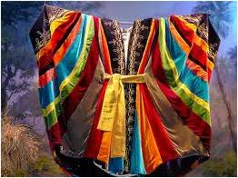
The Garment Of Praise
Outfit of the Day

Slide 2
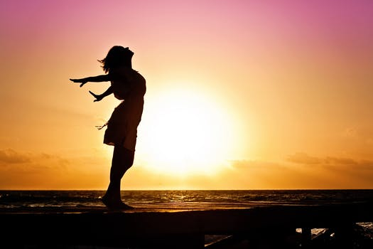
The Garment Of Praise
Isaiah 61:3 To appoint unto them that mourn in Zion, to give unto them beauty for ashes, the oil of joy for mourning, the garment of praise for the spirit of heaviness; that they might be called trees of righteousness, the planting of the Lord, that he might be glorified.

Slide 3
What Is Praise?
A Sacrifice (Hebrews 13:15; Psalm 61:8)
Eternal (Psalm 104:33; Psalm 35:28)
Acknowledgement (Psalm 51:14; Daniel 2:23; 1 Peter 2:9)
Humility (Daniel 4:37)
Recognition (Daniel 4:34)
Therapy (Isaiah 61:3)
Victory Chant (Exodus 15:2; Psalm 47:1)
A Commandment (Psalms 150)
Perspective (Jeremiah 17:14; Psalm 29:2 Psalm 34:1-3)
A Weapon (Acts 16)

Slide 4
Praise Is A Weapon – Acts 16
6 Now when they had gone throughout Phrygia and the region of Galatia, and were forbidden of the Holy Ghost to preach the word in Asia, 7 After they were come to Mysia, they assayed to go into Bithynia: but the Spirit suffered them not. 8 And they passing by Mysia came down to Troas. 9 And a vision appeared to Paul in the night; There stood a man of Macedonia, and prayed him, saying, Come over into Macedonia, and help us. 10 And after he had seen the vision, immediately we endeavoured to go into Macedonia, assuredly gathering that the Lord had called us for to preach the gospel unto them. 11 Therefore loosing from Troas, we came with a straight course to Samothracia, and the next day to Neapolis; 12 And from thence to Philippi, which is the chief city of that part of Macedonia, and a colony: and we were in that city abiding certain days. 13 And on the sabbath we went out of the city by a river side, where prayer was wont to be made; and we sat down, and spake unto the women which resorted thither. 14 And a certain woman named Lydia, a seller of purple, of the city of Thyatira, which worshipped God, heard us: whose heart the Lord opened, that she attended unto the things which were spoken of Paul. 15 And when she was baptized, and her household, she besought us, saying, If ye have judged me to be faithful to the Lord, come into my house, and abide there. And she constrained us. 16 And it came to pass, as we went to prayer, a certain damsel possessed with a spirit of divination met us, which brought her masters much gain by soothsaying: 17 The same followed Paul and us, and cried, saying, These men are the servants of the most high God, which shew unto us the way of salvation. 18 And this did she many days. But Paul, being grieved, turned and said to the spirit, I command thee in the name of Jesus Christ to come out of her. And he came out the same hour. 19 And when her masters saw that the hope of their gains was gone, they caught Paul and Silas, and drew them into the marketplace unto the rulers,

Slide 5
Praise Is A Weapon – Acts 16
20 And brought them to the magistrates, saying, These men, being Jews, do exceedingly trouble our city, 21 And teach customs, which are not lawful for us to receive, neither to observe, being Romans. 22 And the multitude rose up together against them: and the magistrates rent off their clothes, and commanded to beat them. 23 And when they had laid many stripes upon them, they cast them into prison, charging the jailor to keep them safely: 24 Who, having received such a charge, thrust them into the inner prison, and made their feet fast in the stocks. 25 And at midnight Paul and Silas prayed, and sang praises unto God: and the prisoners heard them. 26 And suddenly there was a great earthquake, so that the foundations of the prison were shaken: and immediately all the doors were opened, and every one's bands were loosed. 27 And the keeper of the prison awaking out of his sleep, and seeing the prison doors open, he drew out his sword, and would have killed himself, supposing that the prisoners had been fled. 28 But Paul cried with a loud voice, saying, Do thyself no harm: for we are all here.

Slide 6
Praise Is A Weapon – Acts 16
29 Then he called for a light, and sprang in, and came trembling, and fell down before Paul and Silas,30 And brought them out, and said, Sirs, what must I do to be saved? 31 And they said, Believe on the Lord Jesus Christ, and thou shalt be saved, and thy house. 32 And they spake unto him the word of the Lord, and to all that were in his house. 33 And he took them the same hour of the night, and washed their stripes; and was baptized, he and all his, straightway. 34 And when he had brought them into his house, he set meat before them, and rejoiced, believing in God with all his house.

Slide 7
There is Victory in Praise – Joshua 6
Now Jericho was straitly shut up because of the children of Israel: none went out, and none came in. 2 And the Lord said unto Joshua, See, I have given into thine hand Jericho, and the king thereof, and the mighty men of valour. 3 And ye shall compass the city, all ye men of war, and go round about the city once. Thus shalt thou do six days. 4 And seven priests shall bear before the ark seven trumpets of rams' horns: and the seventh day ye shall compass the city seven times, and the priests shall blow with the trumpets. 5 And it shall come to pass, that when they make a long blast with the ram's horn, and when ye hear the sound of the trumpet, all the people shall shout with a great shout; and the wall of the city shall fall down flat, and the people shall ascend up every man straight before him.
20 So the people shouted when the priests blew with the trumpets: and it came to pass, when the people heard the sound of the trumpet, and the people shouted with a great shout, that the wall fell down flat, so that the people went up into the city, every man straight before him, and they took the city.

Slide 8
Praise Must Be Perfected
Proverbs 27:21 As the fining pot for silver, and the furnace for gold, so is a man to his praise.
Perfected Praise is maturing to the level to praise in any situation
Matthew 21:16 And said unto him, Hearest thou what these say? And Jesus saith unto them, Yea; have ye never read, Out of the mouth of babes and sucklings thou hast perfected praise?
Psalms 8:2 Out of the mouth of babes and sucklings has thou ordained strength because of thine enemies, that thou mightiest still the enemy and avenger.
We mature to dependency

Slide 9
Discussion Question
What are some things that try to stop our praise?

Slide 10
What Things Try TO Stop Our Praise?
Heaviness / Weights (Hebrews 12:2)
Circumstances / Sufferings (Psalm 30:11-12)
Sorrows (Isaiah 35:10; Matthew 5:4)
Trafficking
Sin
Idols (Isaiah 42:8)
Imaginations (1 Corinthians 10:4-5)

