Slide 1
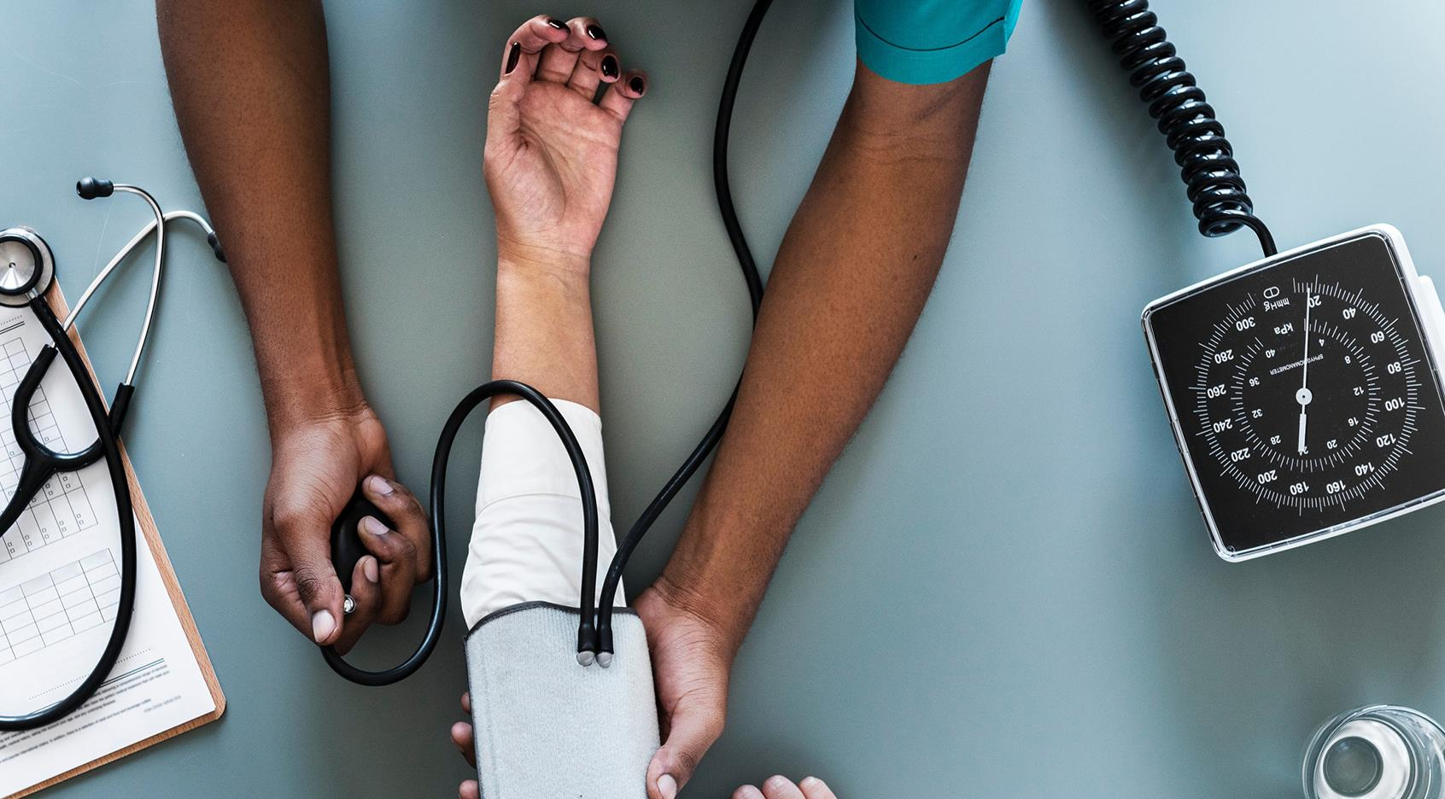
The Spiritual Eye Exam
The Operation Series

Slide 2
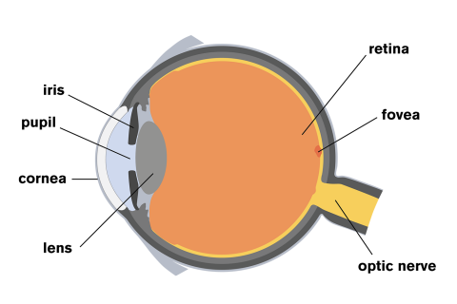
How the Eye Works
Matthew 6:22-23 The light of the body is the eye: if therefore thine eye be single, thy whole body shall be full of light. But if thine eye be evil, thy whole body shall be full of darkness. If therefore the light that is in thee be darkness, how great is that darkness!
Vision Depends as much on your brain as does your eyes. (2 Cor. 4:4)
The eye’s main job is to detect patterns of light. It works with your brain to turn them into images.
Light reflects off an object into your eye (cornea). It then enters the pupil, which is controlled by the Iris. In bright light, the pupil narrows, in dark light, it widens. (Matt. 6:22-23)
The lens focusses so you can see things clearly.
The retina turns light into electrical signals which go through the optic nerve. (cable from the eye to the brain.) (1 Pet. 1:13)
The retina detects images upside down, but your brain is responsible for making them right-side up. (Phil. 2:5; Rom. 12:1-2)

Slide 3
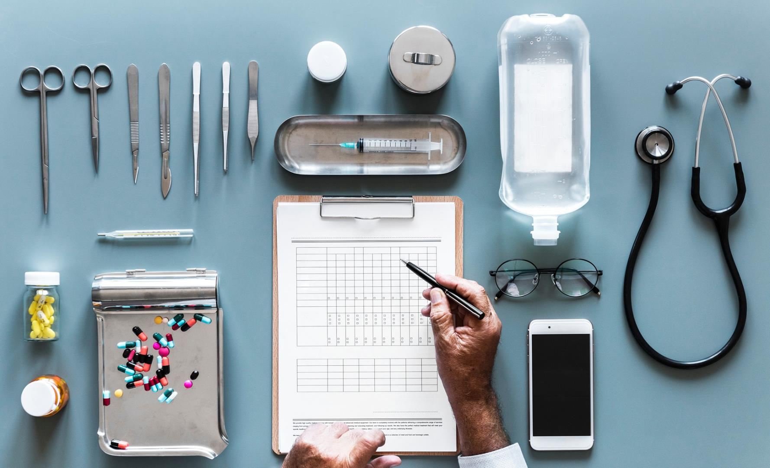
Discussion Question
Do you perceive things differently since following Christ?

Slide 4
The Diagnosis: Blindness
Partial Blindness: Has very limited vision.
Legally Blind: Vision that is worse than 20/200 with glasses or contact lenses.
Complete Blindness: Cannot see anything and does not see light.
Complete blindness means that you can’t see at all and are in total darkness.(John 3:19-20)
We must be mindful of who we follow. (Matt. 15:14)
Facts about Blindness:
Rates of blindness will double by 2020. (1 Tim. 4:1-2)
Half of all blindness is preventable. (2 Pet. 3:9)
1 in 4 school children has a serious vision problem. (Prov. 22:6)
Diabetics are 25x more likely to become blind. (2 Tim 4:3)
Smoking causes blindness. (Lev. 10:1-2)
Luke 4:18-19 The Spirit of the Lord is upon me, because he hath anointed me to preach the gospel to the poor; he hath sent me to heal the brokenhearted, to preach deliverance to the captives, and recovering of sight to the blind, to set at liberty them that are bruised, To preach the acceptable year of the Lord.

Slide 5
Healing the Blind
Mark 8:22-26 And he cometh to Bethsaida; and they bring a blind man unto him, and besought him to touch him. 23 And he took the blind man by the hand, and led him out of the town; and when he had spit on his eyes, and put his hands upon him, he asked him if he saw ought. 24 And he looked up, and said, I see men as trees, walking. 25 After that he put his hands again upon his eyes, and made him look up: and he was restored, and saw every man clearly. 26 And he sent him away to his house, saying, Neither go into the town, nor tell it to any in the town.
Restoring sight is the restoration of God’s image (John 9:1-12)
Sight has to be restored spiritually. Seeing men “as trees” is spiritual sight. (Mark 8:22-25)
Receiving sight requires confession and engagement (Mark 10:46-52)
Physical sight can be diametrically opposed to spiritual sight. (2 Cor. 5:7)
Paul went a season without physical sight to develop the faith and humility required for his calling (Acts 9:17-20)

Slide 6
Three Takeaways
Spiritual Vision (The Operation Series)
Your Mind’s Eye
Blindness
Healing the Blind
The eye is responsible for detecting patterns of light. These lights are then transmitted to the brain. Spiritually, we have to be able to recognize the light of Christ and have a mind to receive it. We are reminded in scripture to renew our mind and put on the Mind of Christ because without his perception, we see things upside down.
Complete blindness is the inability to see anything, not even light. This results in an existence of total darkness. It is estimated that blindness will double by the year 2020. This is in alignment with scripture that warns us that many shall depart from the faith and that the love of many shall wax cold. We must let the light of Christ rule in us.
Healing the blind was a primary part of Jesus’ ministry. Healing the blind is restoring man into his proper image. It takes faith to be able to receive a healing, and fortunately, faith comes by hearing and not by sight. Spiritual vision is paramount and can go against what we see in the natural, so we must walk by faith and not by sight.

