Slide 1
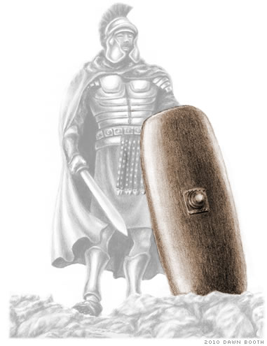
The Shield of Faith
Outfit of the day series (OOTD)

Slide 2
What is the Shield of Faith?
Galatians 6:16 Above all, taking the shield of faith, wherewith ye shall be able to quench all the fiery darts of the wicked.
A shield, long and oblong, protecting every part of the soldier
Offense
Hebrews 11:1 Now faith is the substance of things hoped for, the evidence of things not seen.
Dependency on God / Glorification of God
Enabler Matthew 13:58 And he did not many mighty works there because of their unbelief

Slide 3
Discussion Question
What Does Faith Look Like?

Slide 4
How the Lord Sees Faith
Mark 2:3-5 And they come unto him, bringing one sick of the palsy, which was borne of four. And when they could not come nigh unto him for the press, they uncovered the roof where he was: and when they had broken it up, they let down the bed wherein the sick of the palsy lay. When Jesus saw their faith, he said unto the sick of the palsy, Son, thy sins be forgiven thee.
Hebrews 11

Slide 5
How IS Our Faith Strengthened?
Cultivating A Relationship With God (Jude 1:20-21)
Tribulation (James 1:2-4; Romans 5:3-5)
Experience (1 Samuel 17:34-36)
Obedience (Psalm 34:8)
Be spiritually minded (Romans 4:17)

Slide 6
Faith Is Vital
Romans 1:16-17 For I am not ashamed of the gospel of Christ: for it is the power of God unto salvation to every one that believeth; to the Jew first, and also to the Greek. For therein is the righteousness of God revealed from faith to faith: as it is written, The just shall live by faith.
Ephesians 2:8-9 For by grace are ye saved through faith; and that not of yourselves: it is the gift of God: Not of works, lest any man should boast.

Slide 7
How do We distinguish dead works from faith works?
Faith Works have a Word
Faith Works give God glory

