Slide 1
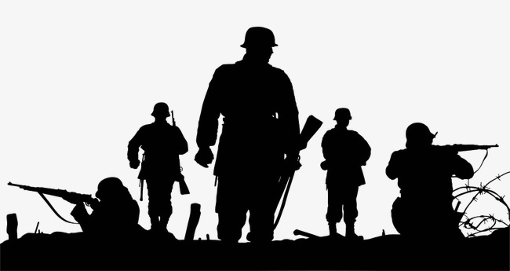
Tearing Down Strongholds
Spiritual Warfare Series

Slide 2
Compassing the Wall
Now Jericho was straitly shut up… (Josh. 6:1)
Crossing over represents salvation. Jericho’s wall represents strongholds.
The enemy will work to keep the strongman secure, especially when God is moving in your life.
Jericho’s wall was thought to be 11 ft high 14 ft wide at a 35 degree angle.
Normally, these cities were only defeated by assault or surrounding them until starvation, which took months and resulted in heavy loss.

Slide 3
The construction
Strongholds / walls are constructed through lies and build up in the mind. (2 Cor. 10:3-6)
Imaginations, high things against the knowledge of God, bringing every thought into captivity are all areas of the mind.
Words are used to shape and mold. What are you forming?
Thoughts and lies always have an origin. The longer they fester, the more they can be solidified and built upon.
Our toughest strongholds are lies that have existed for years and fortified.
Lies must be aborted upon conception. (Js. 1:14-15)
Many of the fiery darts that are thrown at us are lies, which are thwarted by faith. (Eph. 6:16)

Slide 4
The destruction
Joshua was instructed to march around Jericho 7 times with priests carrying the ark (presence of God). (Josh. 6:6-
We must saturate our minds with the presence of God to have a mind conducive for victory.
This includes praise, worship, reading the word, prayer, and fasting.
The people were commanded to be silent during the marches around Jericho until Joshua told them to shout. (Josh. 6:10)
We must know when to be silent and let God fight our battles. (Prov. 3:5-6)
The shout is the word of God being used against our circumstances.

Slide 5
Maintaining Victory
We cannot try to hold onto any remnants of our “Jericho.” (Josh. 6:17-19)
Achan stole some gold and silver and was responsible for the children of Israel losing against Ai (Josh. 7:1)
Deliverance must be maintained, by not letting anyone rebuild the city.
We cannot believe lies once we have been freed by truth. (Josh. 6:26)
The enemies strategy is to rebuild the city after it’s torn down. He already has the blueprints and it is familiar to our flesh. (Eph. 4:22-25/Rom. 7:21-25)
We must maintain an atmosphere of the presence of the LORD in order to maintain victory. This is why He told Joshua to meditate on His law day and night.
Unholy influences are another quick way to sabotage victory.

Slide 6
Discussion Question
What are the barriers to tearing down mental strongholds and how do we defeat them?

Slide 7
3 Takeaways
Strongholds / and walls are build up in our minds. The longer they are with us, the more fortified they become. The battle is in our minds against imaginations and thoughts. We must fight with faith.
In order to gain victory, we must have an atmosphere that is conducive for victory. This means filling our minds with the presence of God, so that when His word goes forth, it can tear down walls.
We must maintain deliverance after a victory. The enemy and our flesh know the blueprints to what has worked on us before, so we must utterly destroy everything and cast down any thoughts that try to rebuild lies into our minds.

